Slide 1
A MACHINE LEARNING MODEL PIPELINE FOR DETECTING WET PAVEMENT CONDITION FROM LIVE SCENES OF TRAFFIC CAMERAS
PRESENTED BY : MUHAMMED AV
S7CSE
REG NO:VDA18CS026

Slide 2
CONTENTS
INTRODUCTION
RELATED WORKS
THE SYSTEM
COMPONENTS
MODEL EVALUATION
CONCLUSION
REFERENCE
BACKGROUND SUBTRACTION MODEL
SEGMENTATION MODEL
GRADIENT BOOSTING CLASSIFIER

Slide 3
INTRODUCTION
Awareness of road surface condition is critical to highway safety.
Road surface condition is largely impacted by weather conditions.
Wet pavement conditions significantly reduce surface friction and increase collision risk.
Real time awareness of the pavement condition is a necessity for safe travel on the road.

Slide 4
INTRODUCTION
For example the knowledge of the surface condition can help in making alterations to the ABS to reduce stopping distance.
On the wet surface the stopping distance will normally be more than dry surface.
Making use of publicly available real-time traffic cameras maintained and operated by state or local departments of transportation to monitor and alert weather and road surface conditions.

Slide 5
RELATED WORKS
A predominant element of driver safety is maintaining a safe stopping distance, which is dynamic in nature, affected by speed, weight and road friction factor.
Šabanovič et al implemented a dynamic ABS that exploits a deep learning model to monitor road surface conditions automatically adjusting the ABS for optimal performance before braking occurs.Adapting the ABS system prior to the braking event yielded the best results on wet asphalt, wherein stopping distances decreased by 18% compared to retroactive adjustment braking

Slide 6
RELATED WORKS
However there is a delay in analyzing the road condition and adapting to it ,which is not acceptable as it involves the safety of the passengers
Chowdhury introduced a system that used forward facing cameras mounted on the vehicle to classify the road conditon by segmenting the images and performing a bird’s eye view transformation, which permits a proactive adjustment by which assisted systems can calibrate the braking.
The drawback with this system was that preemptive detection of surface condition was difficult for sensors coupled on a vehicle.

Slide 7
RELATED WORKS
Abundance of CCTV can be useful for analyzing the surface condition.
Fuet used CNN to classify rain from images.Artificial rain was used to train the model.
Rain creates a number of visual changes of which Salot and Swaminarayan evaluated visual features of the sky and characteristics of clouds,such as shape, color, texture and edges, to predict rainfall status.
Road surface wetness can be measured both invasively by sensor embedded in pavement or non-invasively by sensors directly above the surface.

Slide 8
RELATED WORKS
Disavantages of invasive sensors include disruption of traffic for installation,damages due to road conditions and difficulty to maintain and replace.
For segmentation of road scenes, many models have been developed using convolutional neural networks, but rather focused on driverview scenes at the ground level
This study focuses on deep learning segmentation architectures for understanding road scenes captured by existing CCTV cameras.

Slide 9
THE SYSTEM
DATA COLLECTION
Data for this project was culminated from 1132 publicly available live traffic cameras across Pennsylvania, Virginia, and Alabama.
12190 images were collected.
The images were of different quality ranging from 240p to 720p.
The dataset was divided and labeled into 2 equal half of wet and dry pavement conditions
The better the use and nature of data better the quality of learning.
In machine learning its critical to ensure that training and test datasets share similar distributions.
Notes:
Ata

Slide 10
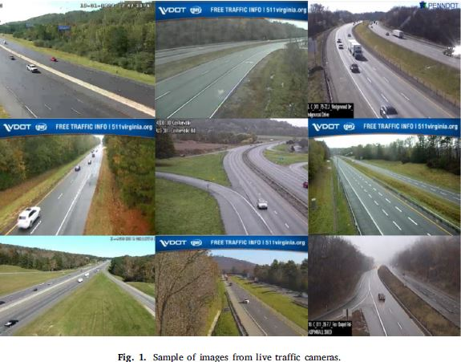
THE SYSTEM
SAMPLE IMAGES FROM CCTV

Slide 11
THE SYSTEM
THE MOTIVATION AND RESEARCH APPROACH
The advancement in machine learning ,especially deep learning has made many tasks as efficient as human or even better than human performance.
A machine learning model pipeline for interpreting weather scenes and predicting the wetness of pavement surface in a timely fashion is proposed
Notes:
ML pipeline is a means of automating the machine learning workflow by enabling data to be transformed and correlated into a model that can then be analyzed to achieve outputs

Slide 12
THE SYSTEM
HSV model has 3 components
Hue - color portion of the model
Saturation - amount of gray in a colour
Value - brigtness/intensity
HSV of the background segments collectively produce visual cues associated with distinct weather conditions that can be used to predict the wetness of pavement.

Slide 13
THE SYSTEM
3 background segment class road,sky and vegetation.
1 special foreground class that consist of traffic signals,logos etc are considered as irrelevant.
During rain water particles scatterlight and the saturation is reduced.
Hue can monitor relative road reflectivity.
The hue and saturation features of overcast condition is similar to that of wet surface.

Slide 14
THE SYSTEM
Reflectance is used in such situations
Percent reflectance can be calculated by reflected light per incident light.
Since traffic cameras are commonly elevated above and angled down toward highways, water film reflects the color of the sky. This causes the road pixel value gains color saturation and brightness that are more analogous to the sky.

Slide 15
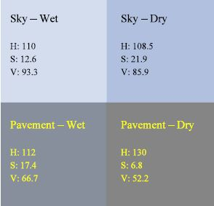
THE SYSTEM
Average pixel values for sky and pavement (wet pavement versus dry pavement)

Slide 16
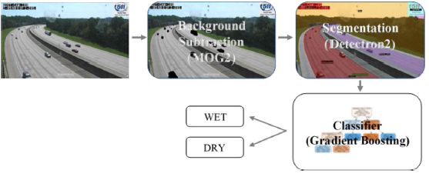
THE SYSTEM
MODEL PIPELINE ARCHITECTURE
Consists of 3 sequential components
Background subtraction model
Segmentation model
Gradient booting classifier

Slide 17
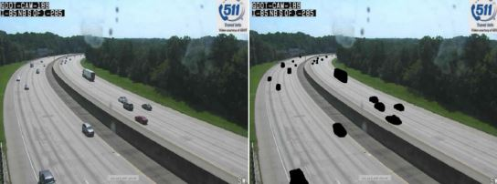
THE SYSTEM
The moving vehicles are masked out using classic Gaussian mixture-based background/foreground segmentation algorithm(MOG2)

Slide 18
COMPONENTS
BACKGROUND SUBTRACTION MODEL
The classic Gaussian mixture-based background/foreground segmentation algorithm (i.e., MOG2)
Used to remove moving vehicles from the cctv images.
Moving pixels and noise are removed from the image
SEGMENTATION MODEL
Conducted using Detectron2, a state-of-the-art PyTorch-based modular object detection library released by Facebook AI Research (FAIR).
3 backbone architectures ResNet-50-FPN, ResNet-101-FPN, and ResNeXt-101-FPN,were selected and used with Mask R-CNN.
Backbone network along with mask CNN were finetuned with custom dataset.

Slide 19
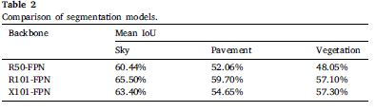
COMPONENTS
The mean IoU results of the finetuned Mask R-CNN with different backbone networks
The concrete medians and utility poles were frequently projected into the pavement and vegetation segments, resulting in irregular segregated areas, which likely contributed to uncertainty in segmentation results

Slide 20
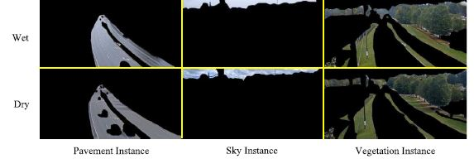
COMPONENTS
High ROI head score threshold of 0.8 for instances detection at the inference stage, which remove small noisy areas
The average pixels values used as feature for downstream classifier.
Segmentation results with the finetuned Mask R-CNN with the ResNet-101-FPN backbone

Slide 21
COMPONENTS
3. GRADIENT BOOSTING CLASSIFIER
Ensemble of trees used to reduce variance.
Gradient boosting algorithms build a collection of trees in a sequential order.
The latter trees rectify errors in the previous ones.
2 popular gradient boosting algorithms were evaluated.
XGBoost and CatBoost
XGBoost entire dataset at each step and CatBoost uses independent data sets.
Notes:
Xgboost dataleakage =poor model performance for smll datasets

Slide 22
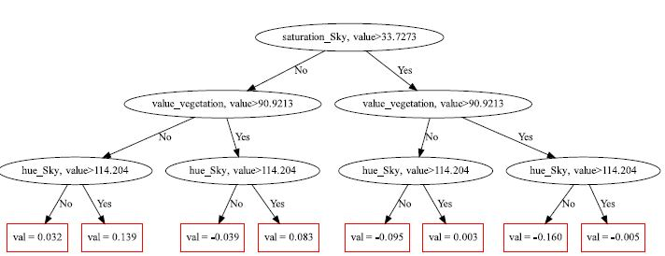
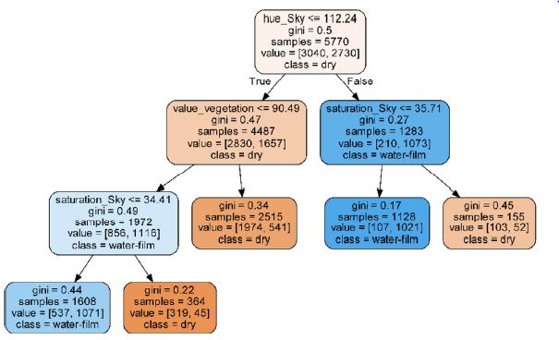
COMPONENTS
An example of XGBoost tree structure.
An example of CatBoost tree structure.

Slide 23
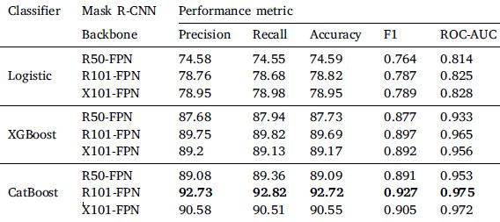
MODEL EVALUATION
Two forms of hyperparameter optimization were experimented:
Gridsearch and Distributed Hyperparameter Optimization (Hyperopt)
Hyperopt outperformed gridsearch
Notes:
AUC - RecvrOprtngCurve is a performance measurement for the classification problems at various threshold setting
Logistic used inline parmtrs
Xg nd cat ensemble nd cn handle nonlinearity

Slide 24
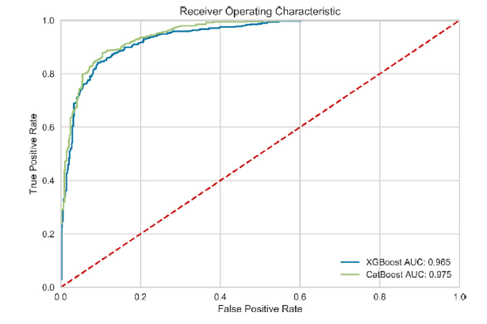
MODEL EVALUATION
R101-FPN backbone is the best segmentation model for both XGBoost and CatBoost classifiers.
The graaph shows the ROC of R101-FPN with both classifiers
Catboost is slightly better than XGBoost as its is visible from the graph

Slide 25
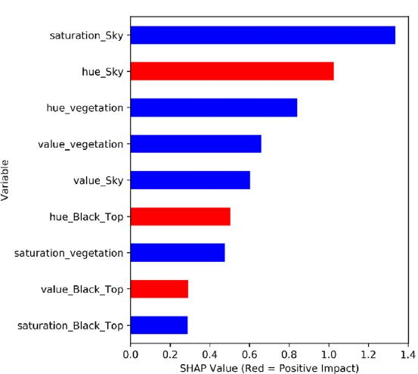
MODEL EVALUATION
Catboost the best classifier is used to analyze the feature impacts on wet surface using SHapley Additive exPlanations (SHAP) value
Blue indicates negative impact and red indicates positive impact.
Sky saturation is the most important feature as it increases ,the wetness of road is minimal.

Slide 26
CONCLUSION
The model tries to bring about a cost effective pavement wetness detection using traffic CCTVs
The Mask R-CNN with the R101-FPN backbone coupled with the CatBoost classifier achievedthe best performance on the test dataset with a 92.7% classification accuracy and an AUC of 97.5%.
Source of variance in data include
Also the data consist of only day time data and cant be used for night time detection Therefore, future studies should be directed at addressing both daytime and nighttime conditions as well as detecting different weather events and a range of varied pavement surface conditions
Changes caused by ageing of road,environmental changes etc
Camera types and model

Slide 27
REFERENCE
[1] Bossu, J., Hautie`re, N., Tarel, J. (2011)., , Rain or snow detection in image sequences through use of a histogram of orientation of streaks. International Journal of Computer Vision, http://dx.doi.org/10.1007/s11263-011- 0421-7.
[2] Chowdhury, S. R., Zhao, M., Jonasson, M., Ohlsson, N. (2019). Methods and systems for generating and using a road friction estimate based on camera image signal processing. application no. us20190340445a1. U.S. Patent.
[3]Salot, N., & Swaminarayan, P. (2015). Classification of cloud types for rainfall forecasting. International Journal of Advanced Networking and Applications, [ISSN: 0975-0290] 7(1), 2626–2629. Simonyan, K., & Zisserman, A. (2014).
[4] Šabanovič, E., Žuraulis, V., Prentkovskis, O., & Skrickij, V. (2020). Identification of road-surface type using deep neural networks for friction coefficient estimation. Sensors, 20(3), 612. http://dx.doi.org/10.3390/s20030612.

Slide 28
THANK YOU

